Slide 1
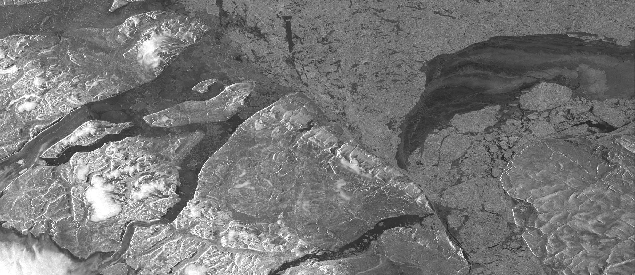
Geospatial Cloud-Native Computing
S3 Télédétection Workshop
Jean-Baptiste Barré, Laurane Charrier, Marin Kneib
April 2024

Slide 2
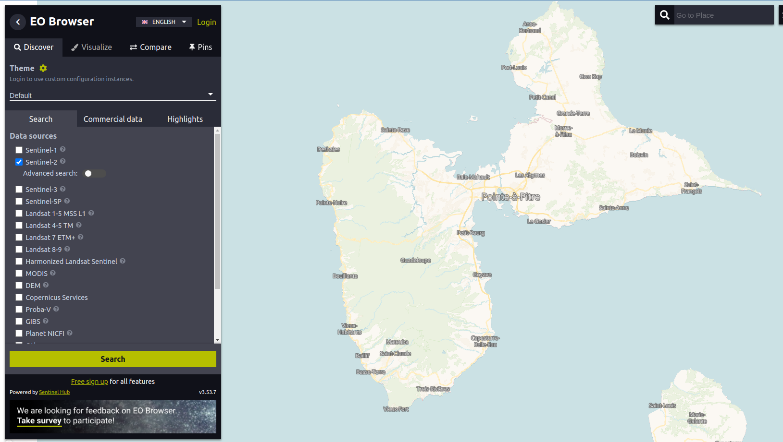
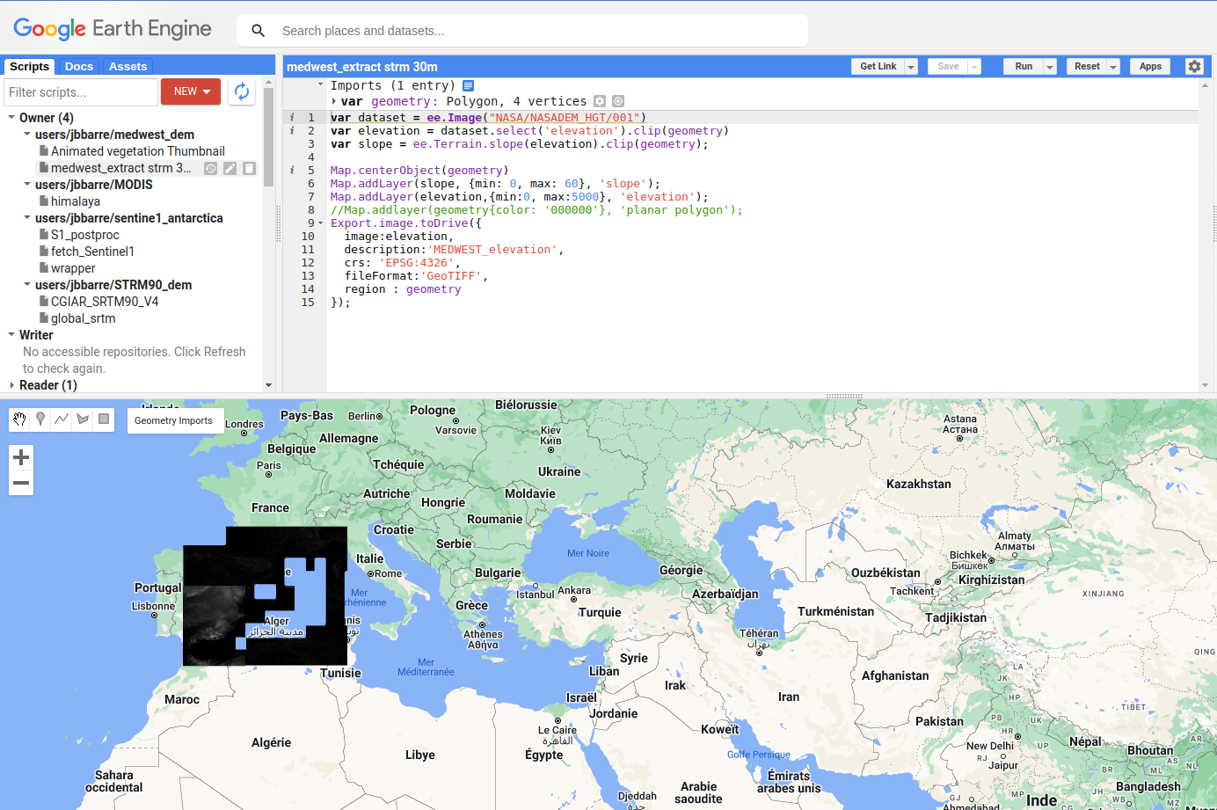
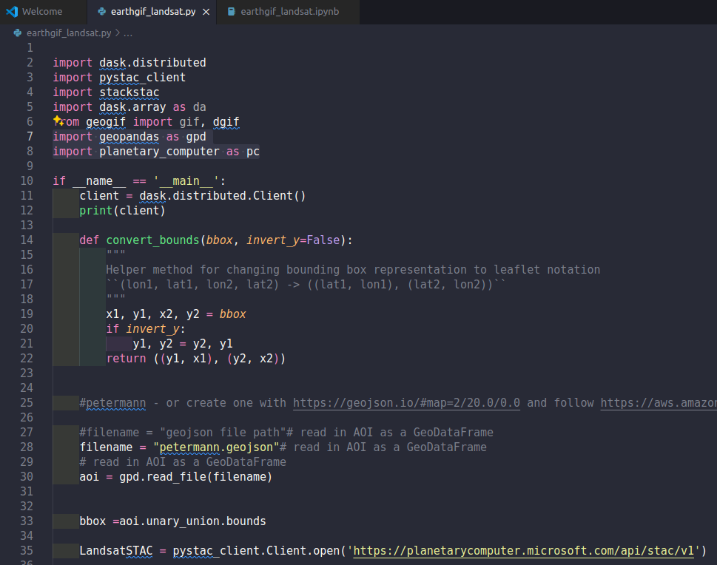
Workshop presentation
1 - Presentation of the key concepts of geospatial cloud computing
2 - Examples and tutorials
without code, with interface : EO-browser
with code, with interface : GEE
with code, without interface : API

Slide 3
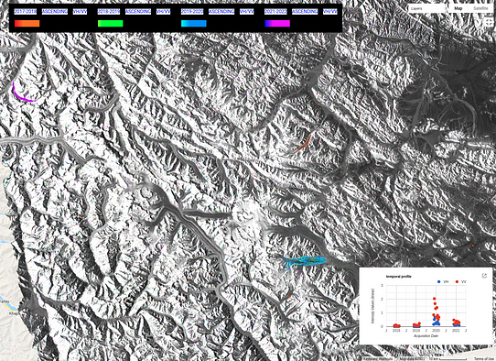
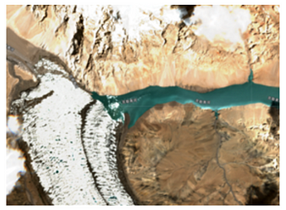
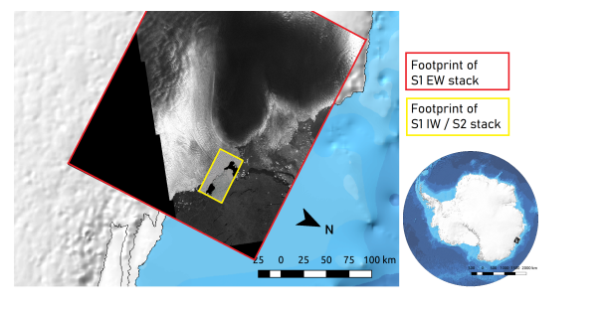
Who are we? What’s our experience ?
Laurane Charrier - Postdoc C2H / Cryodyn
Use of EO-browser and GEE
Teaching and quick vizualization
Image downloading
SAR time series analysis
blog article Colin & Charrier 2021
Charrier et al., 2020 RadarConf
REACTIV by season
blog article Colin & Charrier 2022

Slide 4






Jean Baptiste Barré
Engineer, PhD in instrumentation, signal processing and imaging for environmental applications.
Expertise in geospatial data processing, analysis and visualisation.
Independent scientific engineering activities for
jbbarre.github.io
jb-barré/

Slide 5
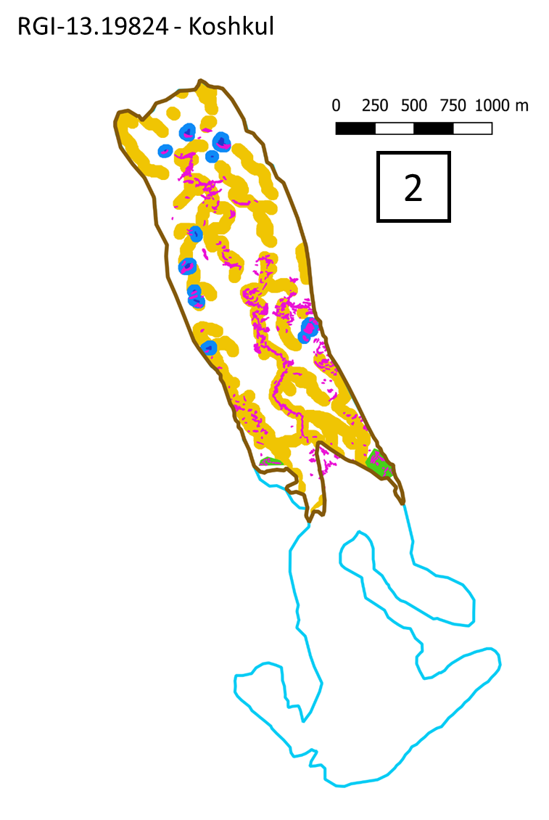
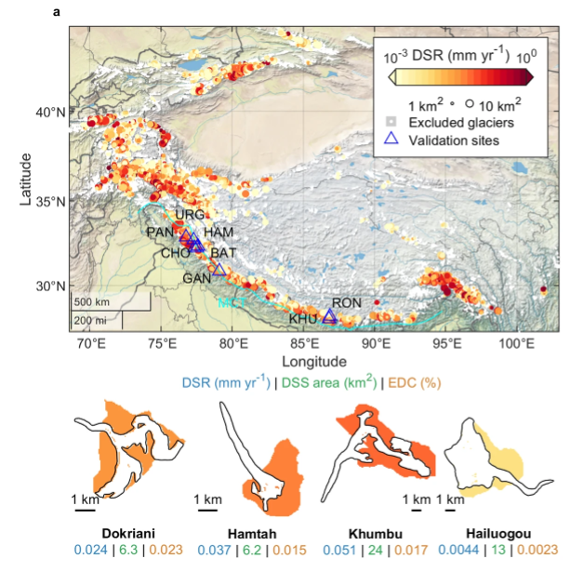
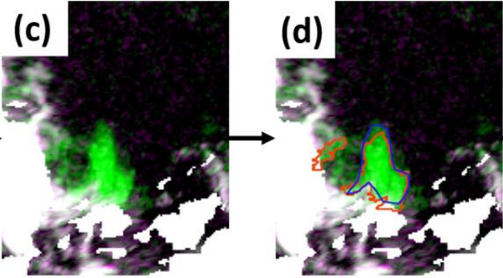
Marin Kneib
Use of GEE to map objects in Sentinel-2 and Sentinel-1 GRD images
Lacs (Kneib et al., 2023, GRL)
Headwalls (McCarthy et al., 2022, CEE)
Avalanches (Kneib et al., TCD)

Slide 6

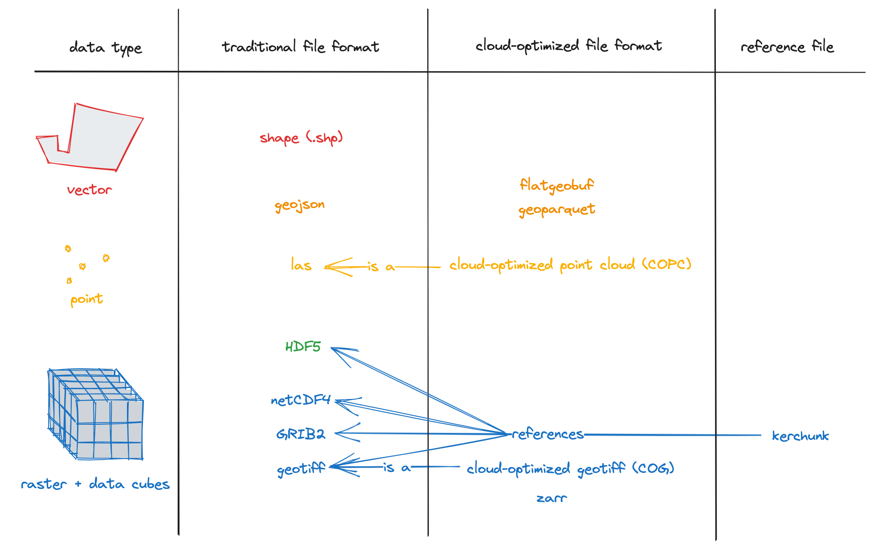
Geospatial Cloud-Native Computing Key concepts
A broad range of services
Geospatial data catalog (STAC specification)
API (JS / Python)
Hubs (GEE Solution / JupyterHub)
Applications (Communication + Services)
Specific format of files
Raster : COG (Cloud Optimised GeoTIFF)
Vector : geoparquet, Flatgeobuf
Datacubes : zarr, kerchunk
« Analysis as close as possible to the data »
« Direct access to data in the area of interest [Partial reads] + Parallel reads + Accessible via HTTP requests »
source : https://guide.cloudnativegeo.org/

Slide 7





Cloud Computing providers Free* service for an academic use
Google Earth Engine
Planetary Computer
Sentinel 1 notamment
Dataspace copernicus.eu/
ASF HyP3
*free but not limited in terms of data volume and workload capacity.
... and probably others.

Slide 8
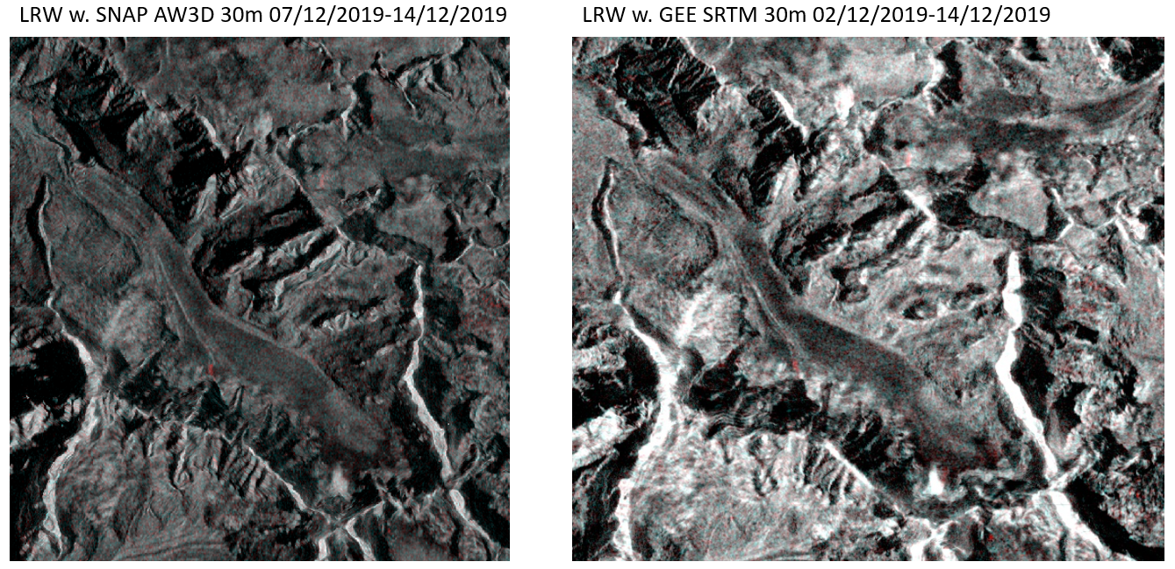
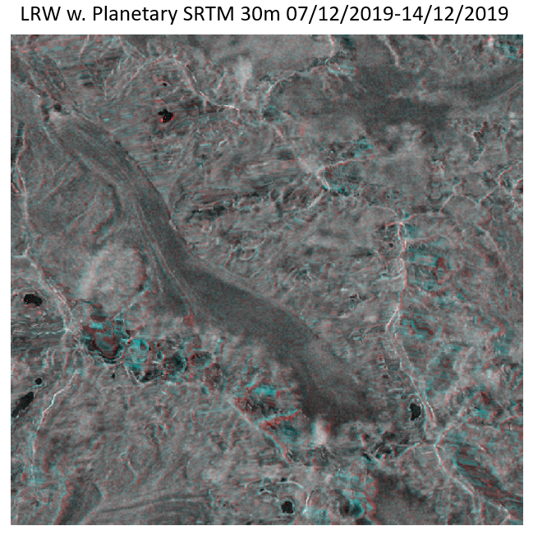
Which plateform to use ?
You need to be careful about the quality of your data, especially when publishing.
Example from Marin : pre-processing & projection images Sentinel-1

Slide 9
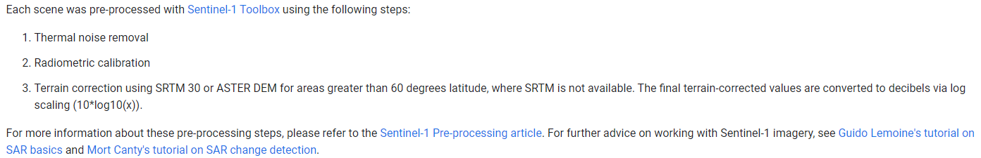
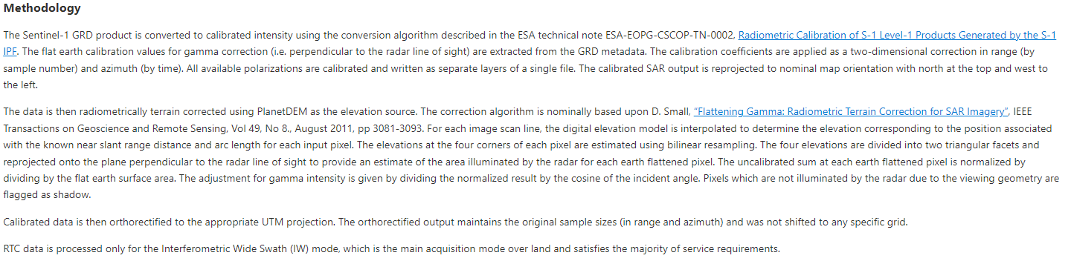
GEE :
Planetary :

Slide 10
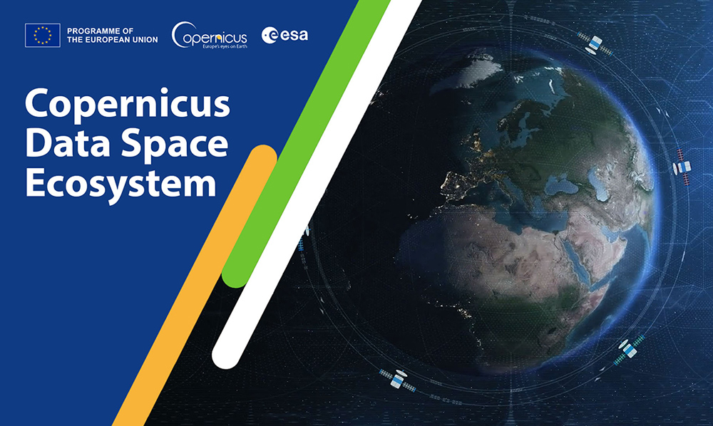
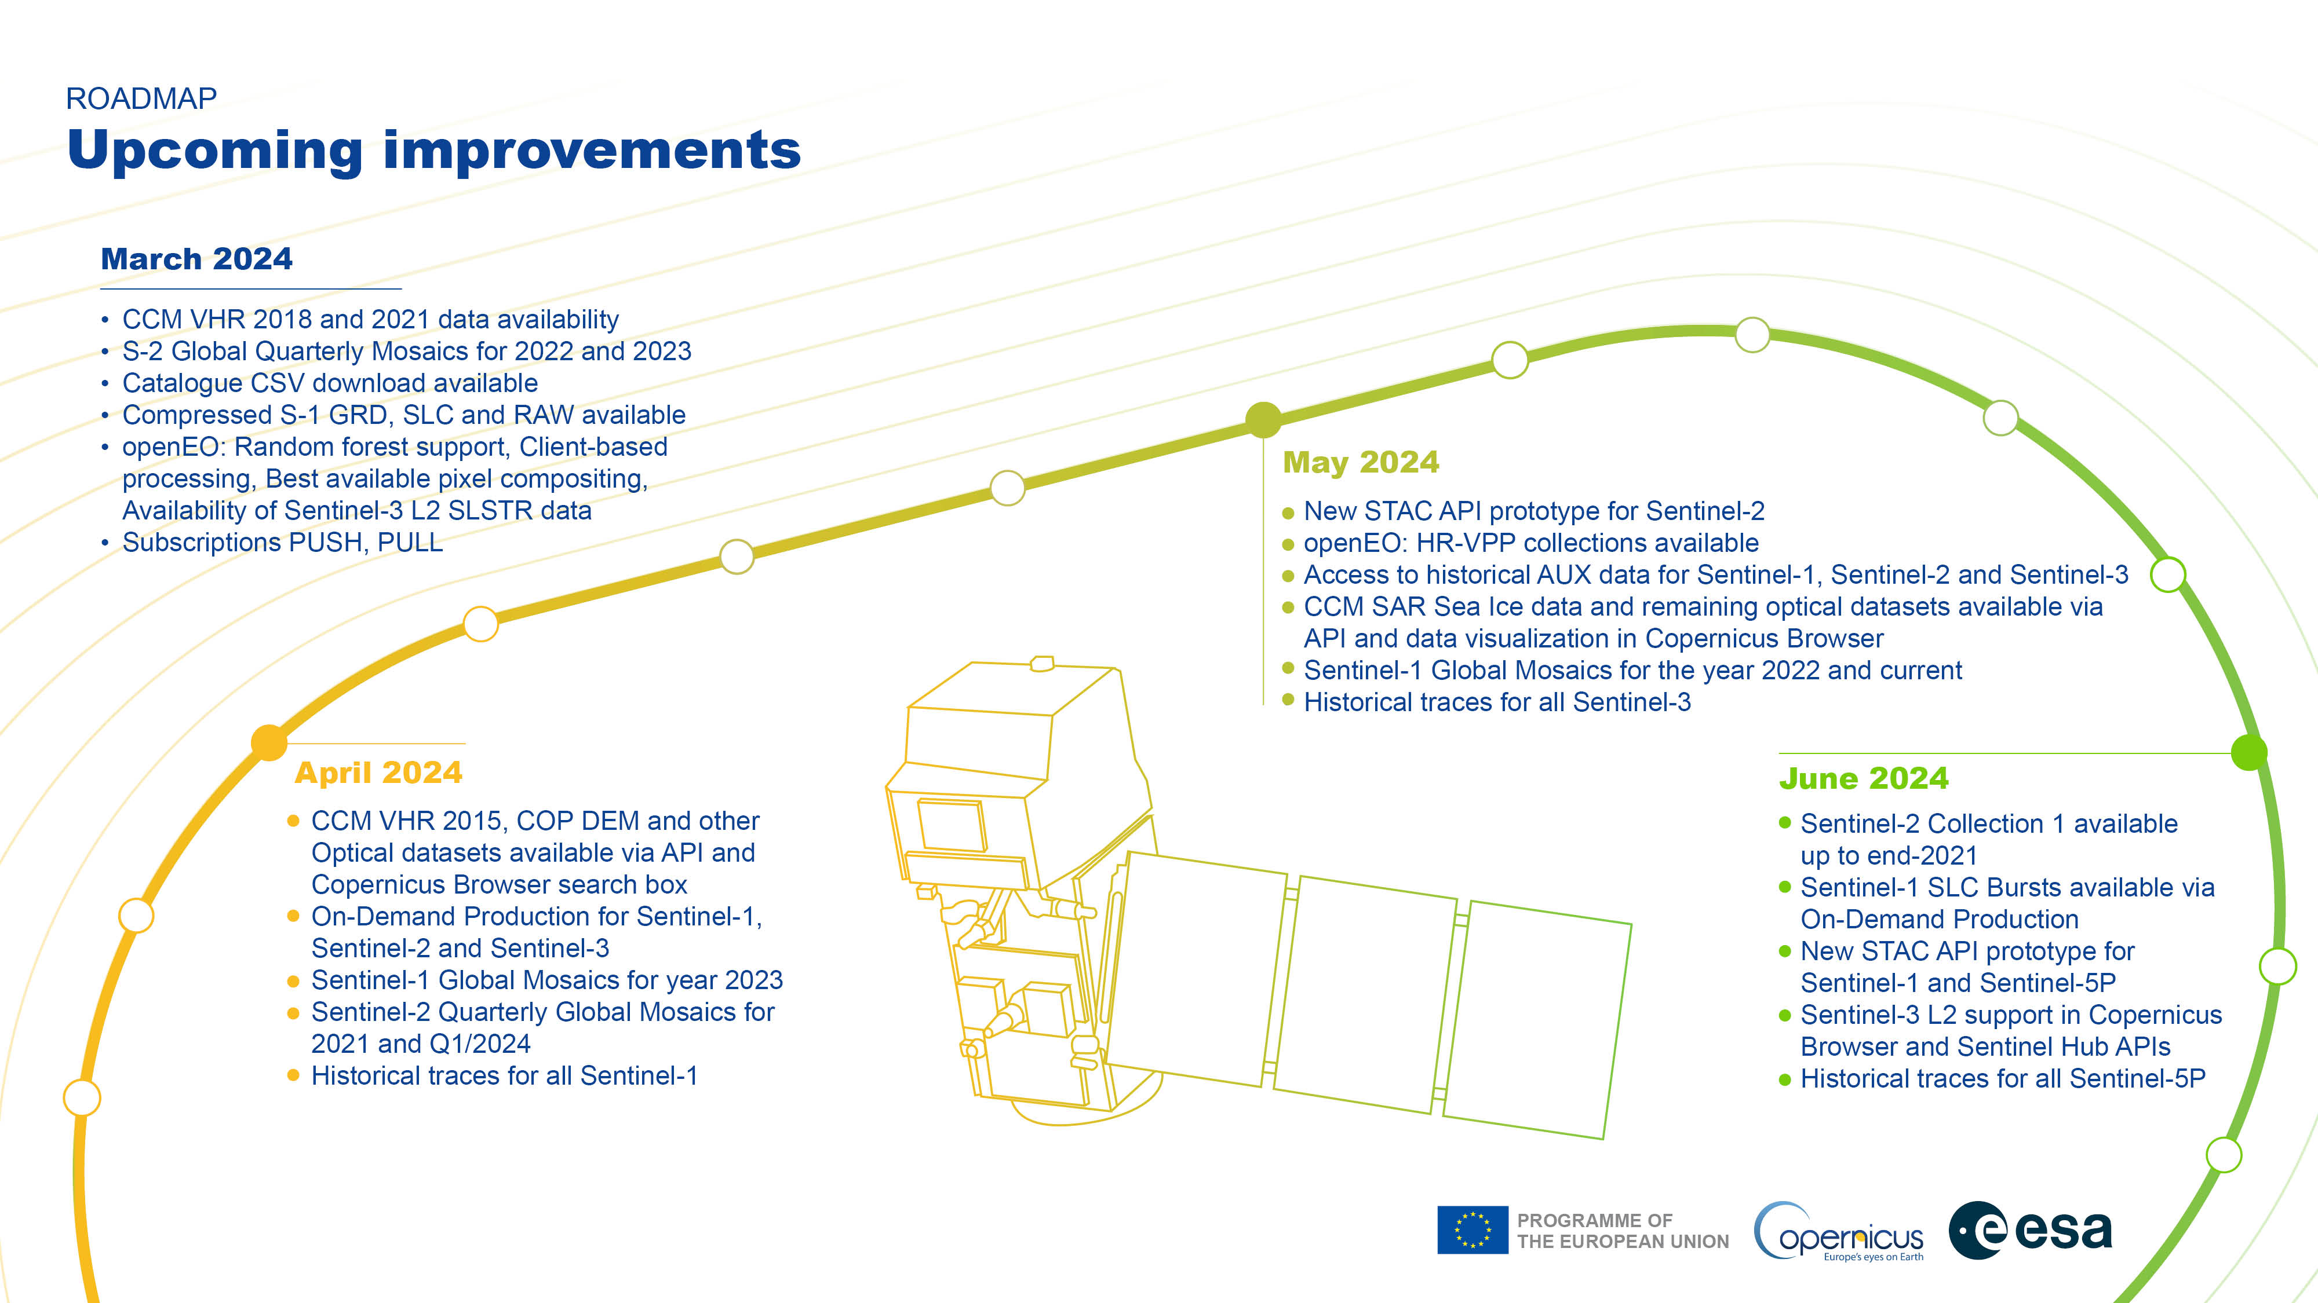
A quick word about Dataspace
Copernicus is the European Union's flagship Earth observation initiative

Slide 11

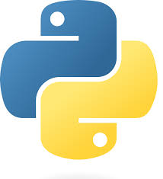
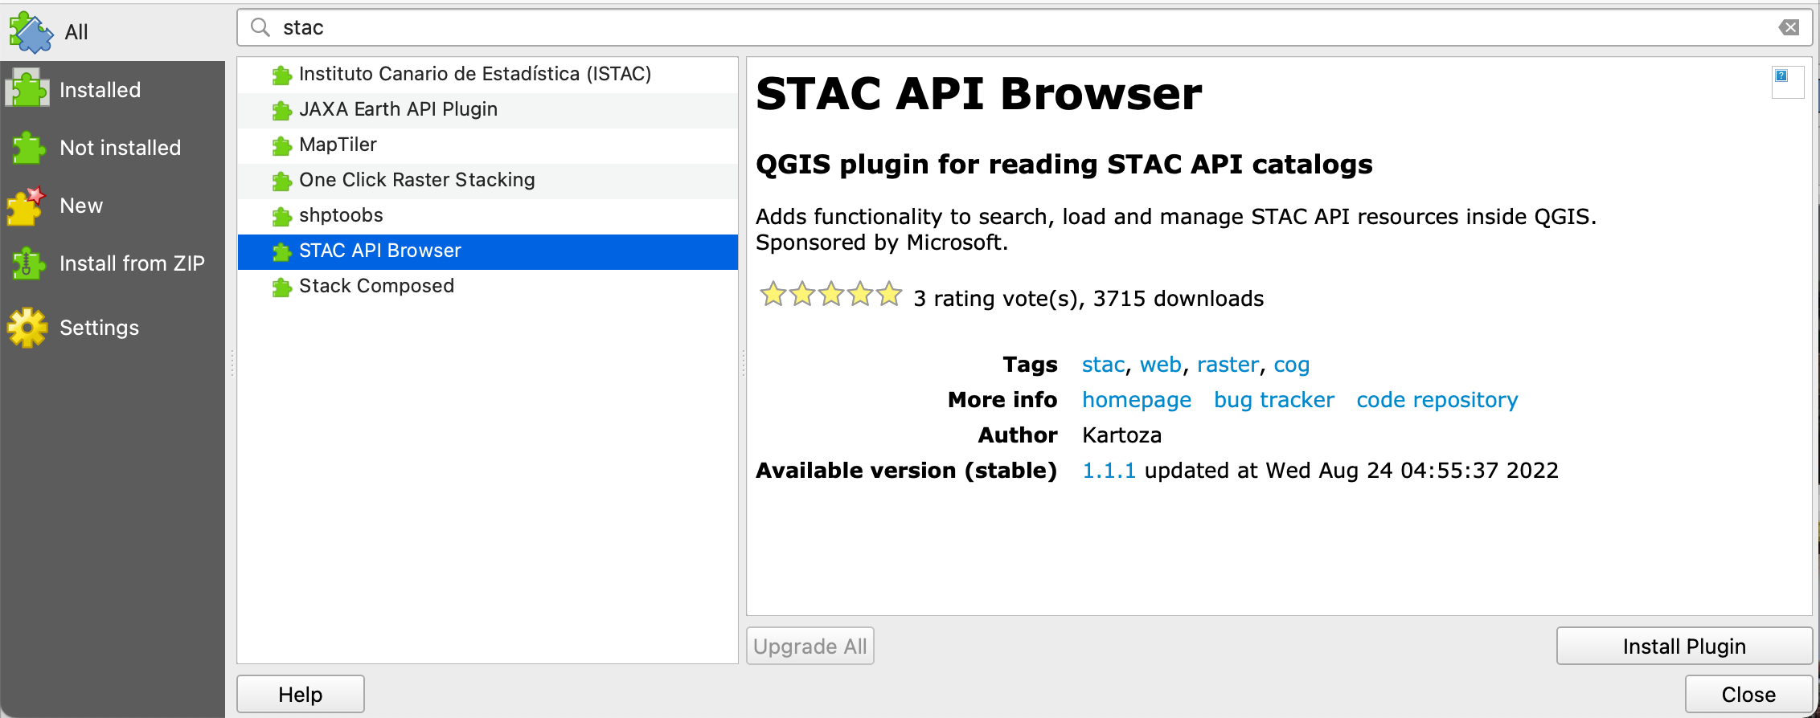
A quick word about STAC
SpatioTemporal Asset Catalogs
a common language to describe geospatial information = Metadata catalog in JSON
Pystac + catalog URL
example : https://catalogue.dataspace.copernicus.eu/stac
Existing STAC Catalogus : https://stacindex.org/catalogs

Slide 12
Ressources
About the topic
https://guide.cloudnativegeo.org/
https://cloudnativegeo.org/
Which Plateform ? Makes your choice
Comparing Google Earth Engine, QGIS & Microsoft Planetary Computer on the same analysis
Pl. Computer vs. GEE: A Compare and Contrast
All the codes are here : https://github.com/IGE-numerique/IGE-Toolkit

